Slide 1
Chapter 6
Special Numbers

Slide 2
Stirling Numbers
Stirling Number First Kind
Stirling Number Second Kind

Slide 3
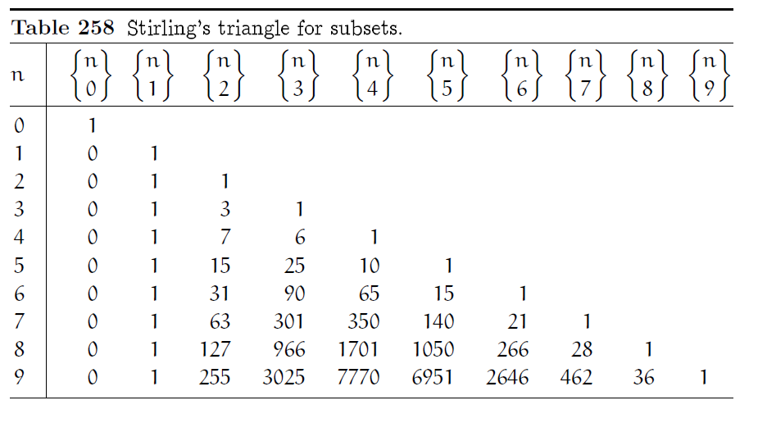
Stirling Number Second Kind

Slide 4



Stirling Number Second Kind
The symbol
stands for the number of ways to partition a set of n things into k nonempty subsets.
For example, there are seven ways to split a four-element set into two parts:
Thus
Can be read as ‘n subset k’ .

Slide 5
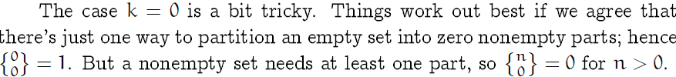
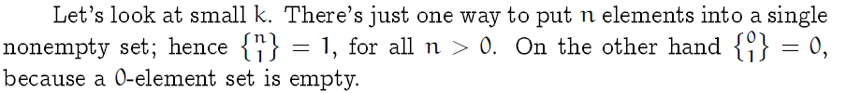
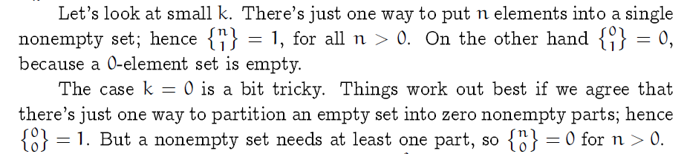
Stirling Number Second Kind

Slide 6
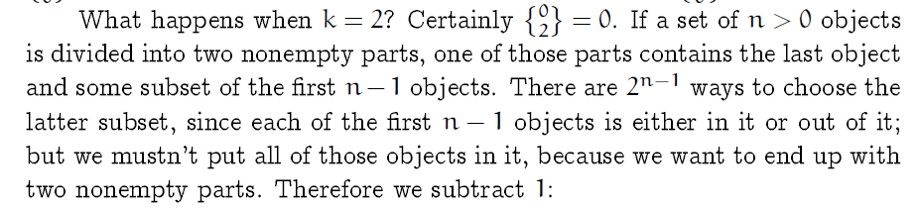

Stirling Number Second Kind
So,

Slide 7




Stirling Number Second Kind
Now we can compute for all.
Given a set of n > 0 objects to be partitioned into k
nonempty parts, we either put the last object into a class by itself in
ways), or we put it together with some nonempty subset of the first n-1 objects. There are
possibilities in the latter case, because each of the
ways to distribute the first n - 1 objects into k nonempty parts gives
k subsets that the nth object can join.
Hence,

Slide 8

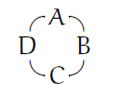
Stirling Number First Kind
counts the number of ways to arrange n objects into k
cycles instead of subsets. We verbalize
by saying “n cycle k."
The cycle
can be written more compactly as '[A, B, C,D]', with the understanding that
a cycle “wraps around" because its end is joined to its beginning. On the other
hand, the cycle [A;,B, C,D] is not the same as [A,B,D,C] or [D, C, B,A].

Slide 9
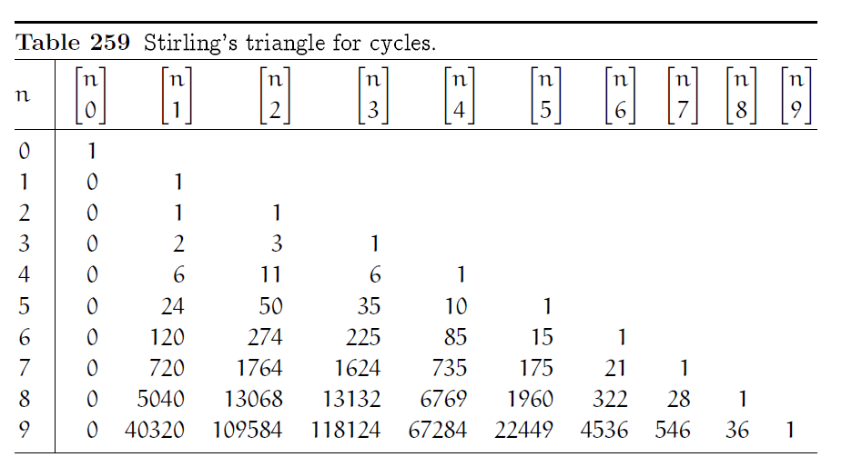
Stirling Number First Kind

Slide 10
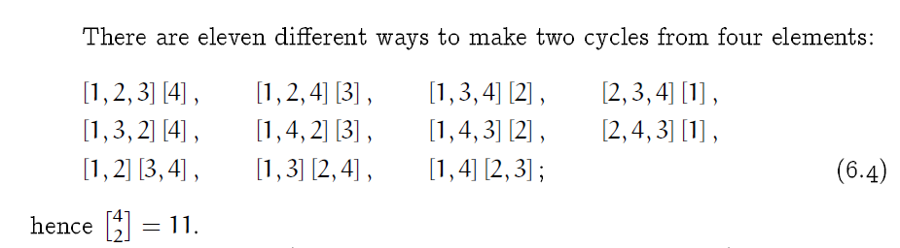
Stirling Number First Kind

Slide 11

Stirling Number First Kind
A singleton cycle (that is, a cycle with only one element) is essentially the same as a singleton set (a set with only one element).
Similarly, a 2-cycle is like a 2-set, because we have [A, B] = [B,A] just as [A, B} = {B,A}. But
there are two different 3-cycles, [A, B,C] and [A, C, B].
Notice, for example,
that the eleven cycle pairs in (6.4) can be obtained from the seven set pairs in (6.1) by making two cycles from each of the 3-element sets.
In general, n!\n = (n - 1)! different n-cycles can be made from any n-element set, whenever n > 0.
Therefore we have,

Slide 12




Stirling Number First Kind
This is much larger than the value for Stirling subset numbers.
In fact, it is easy to see that the cycle numbers must be at least as large as the subset numbers,
because every partition into non empty subsets leads to at least one arrangement of cycles. Equality holds when all the cycles are necessarily singletons or doubletons, because cycles are equivalent to subsets in such cases. This happens
when k = n and when k = n - 1; hence
In fact, it is easy to see that

Slide 13



Stirling Number First Kind
We can derive a recurrence for by modifying the argument we used
for
Every arrangement of n objects in k cycles either puts the last object into a cycle by itself
or inserts that object into one of the cycle arrangements of the first n - 1 objects. In the latter
case, there are n - 1 different ways to do the insertion. When j = 3, for example, the cycle [A, B,C] leads to
when we insert a new element D, and there are no other possibilities. Summing over all j gives a total of n-1 ways to insert an nth object into a cycle decomposition of n - 1 objects. The desired recurrence is therefore

Slide 14
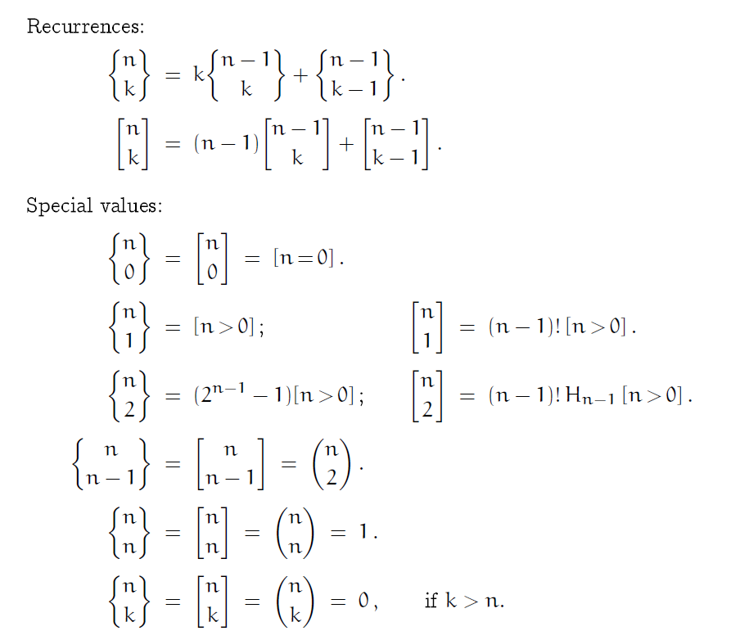
Recurrences

Slide 15
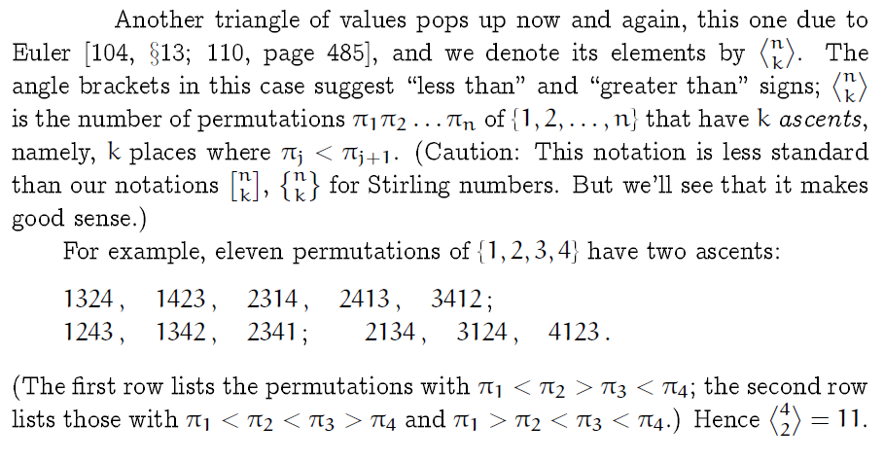
Eulerian Numbers

Slide 16
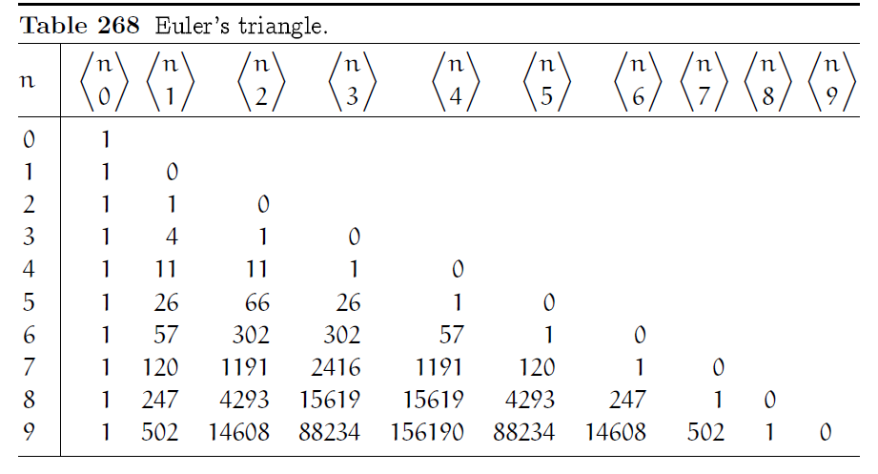
Eulerian Numbers

Slide 17
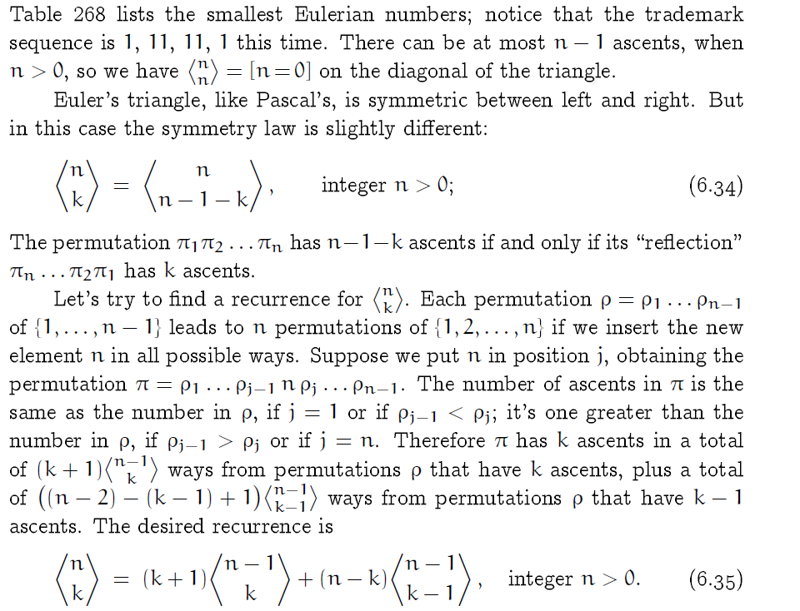
Eulerian Numbers

Slide 18
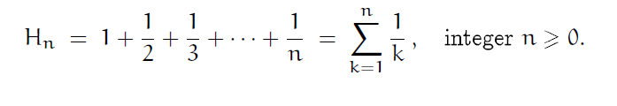

Harmonic Numbers
These numbers appear so often in the analysis of algorithms that computer scientists need a special notation for them. We use Hn, the 'H' standing for harmonic," since a tone of wavelength 1/n is called the n th harmonic of a tone whose wavelength is 1.

Slide 19
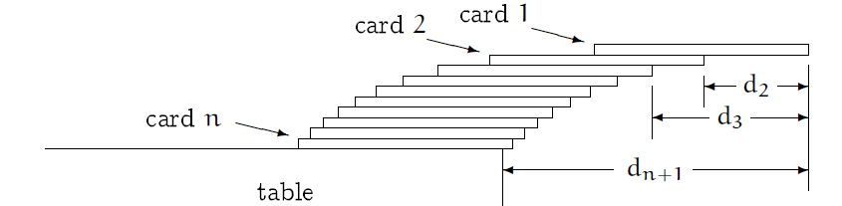
Harmonic Numbers
It can be said that, Hn is never an integer when n>1.
Let’s go for a card trick.

Slide 20
Harmonic Number
Given
n cards
A table
The problem is to find out the largest possible overhang by stacking the cards up over the table's edge, subject to the laws of gravity
Requirement:
the edges of the cards to be parallel to the edge of the table
Each card is 2 units long

Slide 21
Harmonic Number
With one card,
we get maximum overhang when its center of gravity is just above the edge of the table. The center of gravity is in the middle of the card, so we can create half a cardlength, or 1 unit, of overhang.
With two cards,
it's not hard to convince ourselves that we get maximum overhang when the center of gravity of the top card is just above the edge of the second card, and the center of gravity of both cards combined is just above the edge of the table. The joint center of gravity of two cards will be in the middle of their common part, so we are able to achieve an additional half unit of overhang.
So if we generalize, it defines that
The center of gravity of the top k cards lies just above the edge of the k+1st card
(which supports those top k). The table plays the role of the n+1st card.

Slide 22
Harmonic Numbers
Let’s go for algebraically
Let,
dk be the distance from the extreme edge of the top card to the corresponding edge of the kth card from the top.
Then d1 = 0, and
we want to make dk+1 the center of gravity of the first k cards:

Slide 23
Harmonic Number
Now multiply this equation by k
Then,
Now subtracting these two equations
Hence,

Slide 24


Harmonic Number
Now, we can say that
The second card will be offset half a unit past the third, which is a third of a unit past the fourth, and so on. The general formula
If we set k=n then
The total overhang when n cards are stacked.

Slide 25
Worm on the rubber band
An amazing problem to show harmonic number in another guise
Explanation: A slow but persistent worm, W, starts at one end of a meter-long rubber band and crawls one centimeter per minute toward the other end.
At the end of each minute, an equally persistent keeper of the band, K, whose sole purpose in life is to frustrate W, stretches it one meter.
Thus
after one minute of crawling, W is 1 centimeter from the start and 99 from the nish; then K stretches it one meter. During the stretching operation W maintains his relative position, 1% from the start and 99% from the finish;
so W is now 2 cm from the starting point and 198 cm from the goal. After W crawls for another minute the score is 3 cm traveled and 197 to go;

Slide 26

Worm on the rubber band
Let's write down some formulas.
When K stretches the rubber band, the fraction of it that W has crawled stays the same.
Thus he crawls 1/100th of it the first minute,
1/200th the second,
1/300th the third, and so on.
After n minutes the fraction of the band that he's crawled is

Slide 27
Practice problem
Definition: A slow but persistent Superworm,SW, starts at one end of a meter-long rubber band and crawls 50 centimeter per minute toward the other end.
At the end of each minute, an equally persistent keeper of the band, K, whose sole purpose in life is to frustrate SW, stretches it one meter.
Now find out where will be the SW on the band after n minutes?
This problem is called SuperWorm on the rubber band.

